Slide 1
Microprocessor System Design
AVR Microcontroller
Part 3 - Timer
Omid Fatemi

Slide 2
Contents

Slide 3

Timer/counter

Slide 4
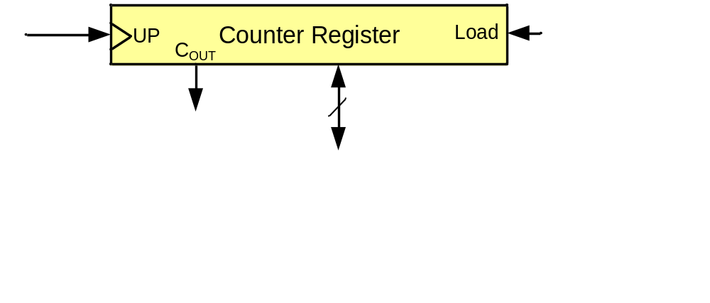
A counter register

Slide 5
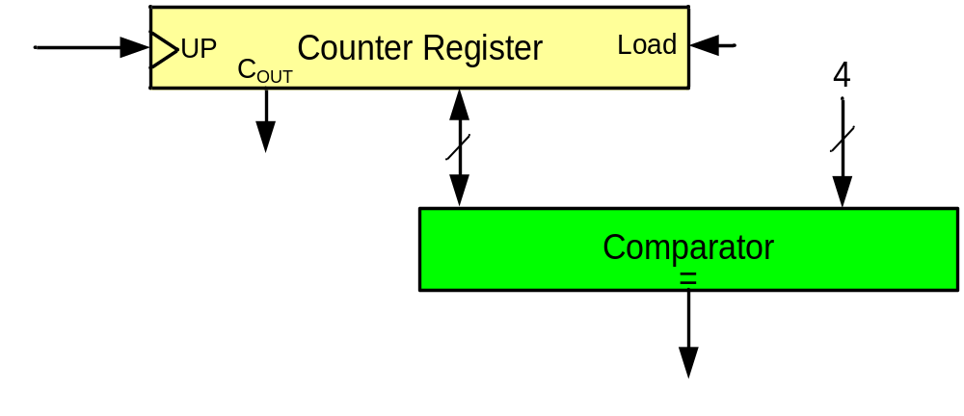
A simple design (counting people)
First design
Sensor

Slide 6
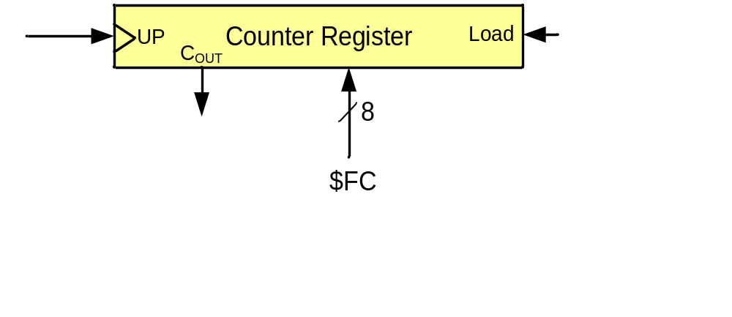
A simple design (counting people)
Second design
Sensor

Slide 7
A simple design (making delay)

Slide 8
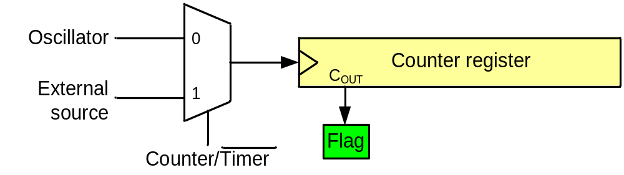
A generic timer/counter
Delay generating
Counting
Wave-form generating
Capturing

Slide 9
Timers in AVR
1 to 6 timers
  3 timers in ATmega32
8-bit and 16-bit timers
  two 8-bit timers and one 16-bit timer in ATmega32

Slide 10
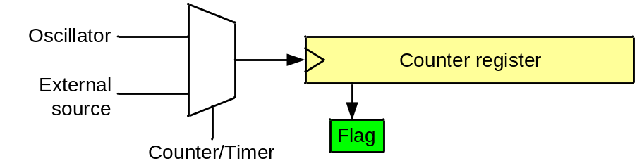
Timer in AVR
TCNTn (Timer/Counter register)
TOVn (Timer Overflow flag)
TCCRn (Timer Counter control register)
OCRn (output compare register)
OCFn (output compare match flag)
TCCRn
TCNTn
TOVn
=
OCFn
Comment:
All of the timer registers are byte-addressable I/O registers
OCRn

Slide 11
Timer 0 (an 8-bit timer)

Slide 12
Timer 0
TCCR0
TCNT0
TOV0
=
OCF0
OCR0

Slide 13
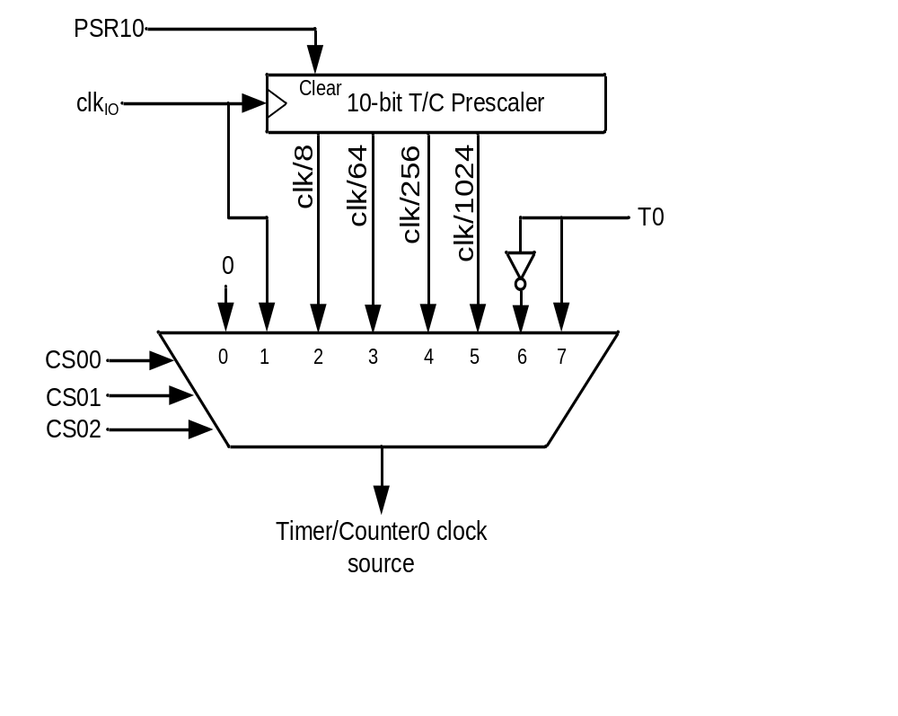
Clock Selector (CS)
Timer Mode (WGM)
CS02 CS01 CS00 Comment
0 0 0 No clock source (Timer/Counter stopped)
0 0 1 clk (No Prescaling)
0 1 0 clk / 8
0 1 1 clk / 64
1 0 0 clk / 256
1 0 1 clk / 1024
1 1 0 External clock source on T0 pin. Clock on falling edge
1 1 1 External clock source on T0 pin. Clock on rising edge
WGM00 WGM01 Comment
0 0 Normal
0 1 CTC (Clear Timer on Compare Match)
1 0 PWM, phase correct
1 1 Fast PWM
Notes:
WGM: waveform generation mode

Slide 14
Normal mode
TCNT0
0xFF
TOV
TOV
TOV
0
time
FF
0
FE
TOV0:
1
2
1
0
TOV0 = 1

Slide 15
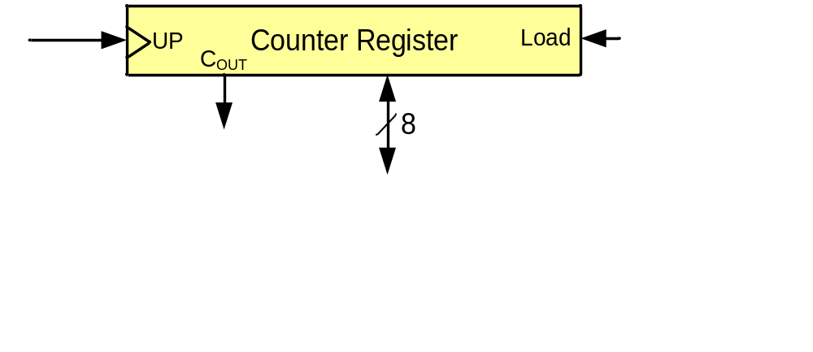
Example 1: Write a program that waits 14 machine cycles in Normal mode.
14 = $0E
$100
-$0E
$F2
$F2
0 0
0 0 1
WGM00 WGM01 Comment
0 0 Normal
0 1 CTC
1 0 PWM, phase correct
1 1 Fast PWM

Slide 16
Example 1: Write a program that waits 14 machine cycles in Normal mode.
$100
-$0E
$F2
.INCLUDE "M32DEF.INC"
LDI R16,0x20
SBI DDRB,5 ;PB5 as an output
LDI R17,0
OUT PORTB,R17
BEGIN: LDI R20,0xF2
OUT TCNT0,R20 ;load timer0
LDI R20,0x01
OUT TCCR0,R20 ;Timer0,Normal mode,int clk
AGAIN: IN R20,TIFR ;read TIFR
SBRS R20,0 ;if TOV0 is set skip next inst.
RJMP AGAIN
LDI R20,0x0
OUT TCCR0,R20 ;stop Timer0
LDI R20,(1<<TOV0) ;R20 = 0x01
OUT TIFR,R20 ;clear TOV0 flag
EOR R17,R16 ;toggle D5 of R17
OUT PORTB,R17 ;toggle PB5
RJMP BEGIN
DDRB = 1<<5;
PORTB &= ~(1<<5); //PB5=0
while (1)
{
TCNT0 = 0xF2;
TCCR0 = 0x01;
while((TIFR&(1<<TOV0))==0);
TCCR0 = 0;
TIFR = (1<<TOV0);
PORTB = PORTB^(1<<5);
}
Question: How to calculate the delay generated
by the timer?
Answer:
1) Calculate how much a machine clock lasts.
T= 1/f
2) Calculate how many machine clocks it waits.
3) Delay = T * number of machine cycles

Slide 17
In example 1 calculate the delay.
XTAL = 10 MHz.
Solution 1 (inaccurate):
1) Calculating T:
T = 1/f = 1/10M = 0.1µs
Calculating num of machine cycles:
$100
-$F2
$0E = 14
Calculating delay
14 * 0.1µs = 1.4 0µs
.INCLUDE "M32DEF.INC"
LDI R16,0x20
SBI DDRB,5 ;PB5 as an output
LDI R17,0
OUT PORTB,R17
BEGIN: LDI R20,0xF2
OUT TCNT0,R20 ;load timer0
LDI R20,0x01
OUT TCCR0,R20 ;Timer0,Normal mode,int clk
AGAIN: IN R20,TIFR ;read TIFR
SBRS R20,0 ;if TOV0 is set skip next inst.
RJMP AGAIN
LDI R20,0x0
OUT TCCR0,R20 ;stop Timer0
LDI R20,0x01
OUT TIFR,R20 ;clear TOV0 flag
EOR R17,R16 ;toggle D5 of R17
OUT PORTB,R17 ;toggle PB5
RJMP BEGIN

Slide 18
Accurate calculating
Other than timer, executing the instructions consumes time; so if we want to calculate the accurate delay a program causes we should add the delay caused by instructions to the delay caused by the timer
LDI R16,0x20
SBI DDRB,5
LDI R17,0
OUT PORTB,R17
BEGIN: LDI R20,0xF2 1
OUT TCNT0,R20 1
LDI R20,0x01 1
OUT TCCR0,R20 1
AGAIN: IN R20,TIFR 1
SBRS R20,0 1 / 2
RJMP AGAIN 2
LDI R20,0x0 1
OUT TCCR0,R20 1
LDI R20,0x01 1
OUT TIFR,R20 1
EOR R17,R16 1
OUT PORTB,R17 1
RJMP BEGIN 2
18
Delay caused by timer = 14 * 0.1µs = 1.4 µs Delay caused by instructions = 18 * 0.1µs = 1.8
Total delay = 3.2 µs ➔ wave period = 2*3.2 µs = 6.4 µs ➔ wave frequency = 156.25 KHz

Slide 19
Finding values to be loaded into the timer
Calculate the period of clock source.
  Period = 1 / Frequency
    E.g. For XTAL = 8 MHz ➔ T = 1/8MHz
Divide the desired time delay by period of clock.
Perform 256 - n, where n is the decimal value we got in Step 2.
Set TCNT0 = 256 - n

Slide 20
Example 2: Assuming that XTAL = 10 MHz, write a program to generate a square wave with a period of 10 ms on pin PORTB.3.
For a square wave with T = 10 µs we must have a time delay of 5 µs. Because XTAL = 10 MHz, the counter counts up every 0.1 µs. This means that we need 5 µs / 0.1 µs = 50 clocks. 256 - 50 = 206.
.INCLUDE "M32DEF.INC"
LDI R16,0x08
SBI DDRB,3 ;PB3 as an output
LDI R17,0
OUT PORTB,R17
BEGIN: LDI R20,206
OUT TCNT0,R20 ;load timer0
LDI R20,0x01
OUT TCCR0,R20 ;Timer0,Normal mode,int clk
AGAIN: IN R20,TIFR ;read TIFR
SBRS R20,TOV0 ;if TOV0 is set skip next
RJMP AGAIN
LDI R20,0x0
OUT TCCR0,R20 ;stop Timer0
LDI R20,0x01
OUT TIFR,R20 ;clear TOV0 flag
EOR R17,R16 ;toggle D3 of R17
OUT PORTB,R17 ;toggle PB3
RJMP BEGIN
DDRB = 1<<3;
PORTB &= ~ (1<<3);
while (1)
{
TCNT0 = 206;
TCCR0 = 0x01;
while((TIFR&0x01) == 0);
TCCR0 = 0;
TIFR = 1<<TOV0;
PORTB = PORTB ^ (1<<3);
}

Slide 21
Example 3: Modify TCNT0 in Example 2 to get the largest time delay possible with no prescaler. Find the delay in µs. In your calculation, do not include the overhead due to instructions.
To get the largest delay we make TCNT0 zero. This will count up from 00 to 0xFF and then roll over to zero.
.INCLUDE "M32DEF.INC"
LDI R16,1<<3
SBI DDRB,3 ;PB3 as an output
LDI R17,0
OUT PORTB,R17
BEGIN: LDI R20,0x0
OUT TCNT0,R20 ;load Timer0
LDI R20,0x01
OUT TCCR0,R20 ;Timer0,Normal mode,int clk
AGAIN: IN R20,TIFR ;read TIFR
SBRS R20,TOV0 ;if TOV0 is set skip next
RJMP AGAIN
LDI R20,0x0
OUT TCCR0,R20 ;stop Timer0
LDI R20,0x01
OUT TIFR,R20 ;clear TOV0 flag
EOR R17,R16 ;toggle D3 of R17
OUT PORTB,R17 ;toggle PB3
RJMP BEGIN
DDRB = 1 << 3;
PORTB &= ~(1<<3);
while (1)
{
TCNT0 = 0x0;
TCCR0 = 0x01;
while((TIFR&(1<<TOV0))==0);
TCCR0 = 0;
TIFR = 0x01;
PORTB = PORTB^(1<<3);
}
Solution
1) Calculating T:
T = 1/f = 1/10MHz = 0.1µs
2) Calculating delay
256 * 0.1µs = 25.6µs

Slide 22
Generating Large Delays
Using loop
Prescaler
Bigger counters

Slide 23

Prescaler and generating a large time delay

Slide 24
CTC (Clear Timer on Compare match) mode
TCNT0
0xFF
OCR0
OCF0
OCF0
OCF0
0
time
OCR0
xx
0
TOV0:
2
0
1
OCF0:
1
0
TOV0 = no change
OCF0 = 1

Slide 25
Rewrite example 2 using CTC
Example 4: Rewrite example 2 using CTC
For a square wave with T = 10 µs we must have a time delay of 5 µs. Because XTAL = 10 MHz, the counter counts up every 0.1 µs. This means that we need 5 µs / 0.1 µs = 50 clocks. Therefore, we have OCR0= 49.
.INCLUDE "M32DEF.INC"
LDI R16,0x08
SBI DDRB,3 ;PB3 as an output
LDI R17,0
OUT PORTB,R17
LDI R20,49
OUT OCR0,R20 ;load timer0
BEGIN: LDI R20,0x09
OUT TCCR0,R20 ;Timer0,CTC mode,int clk
AGAIN: IN R20,TIFR ;read TIFR
SBRS R20,OCF0 ;if OCF0 is set skip next
RJMP AGAIN
LDI R20,0x0
OUT TCCR0,R20 ;stop Timer0
LDI R20,0x02
OUT TIFR,R20 ;clear TOV0 flag
EOR R17,R16 ;toggle D3 of R17
OUT PORTB,R17 ;toggle PB3
RJMP BEGIN
DDRB |= 1<<3;
PORTB &= ~(1<<3);
while (1)
{
OCR0 = 49;
TCCR0 = 0x09;
while((TIFR&(1<<OCF0))==0);
TCCR0 = 0; //stop timer0
TIFR = 0x02;
PORTB.3 = ~PORTB.3;
}

Slide 26
Timer2
Timer0
Timer2
TCCR0
TCCR2
TCNT0
TCNT2
TOV0
TOV2
=
OCF0
=
OCF2
OCR0
OCR2

Slide 27
The difference between Timer0 and Timer2
Timer0
Timer2
CS02 CS01 CS00 Comment
0 0 0 Timer/Counter stopped
0 0 1 clk (No Prescaling)
0 1 0 clk / 8
0 1 1 clk / 64
1 0 0 clk / 256
1 0 1 clk / 1024
1 1 0 External clock (falling edge)
1 1 1 External clock (rising edge)
CS22 CS21 CS20 Comment
0 0 0 Timer/Counter stopped
0 0 1 clk (No Prescaling)
0 1 0 clk / 8
0 1 1 clk / 32
1 0 0 clk / 64
1 0 1 clk / 128
1 1 0 clk / 256
1 1 1 clk / 1024

Slide 28
Timer 1
OCR1BH OCR1BL
=
OCF1B
TCCR1A
TCCR1B
TCNT1H TCNT1L
TOV1
=
OCF1A
OCR1AH OCR1AL

Slide 29
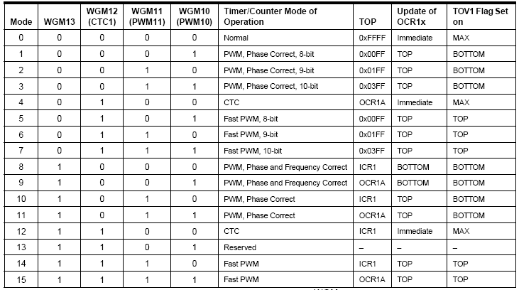

Clock Selector (CS)
CS12 CS11 CS10 Comment
0 0 0 No clock source (Timer/Counter stopped)
0 0 1 clk (No Prescaling)
0 1 0 clk / 8
0 1 1 clk / 64
1 0 0 clk / 256
1 0 1 clk / 1024
1 1 0 External clock source on T0 pin. Clock on falling edge
1 1 1 External clock source on T0 pin. Clock on rising edge

Slide 30
Assuming XTAL = 10 MHz write a program that toggles PB5 once per millisecond, using Normal mode.
XTAL = 10 MHz ➔ 1/10 MHz = 0.1 µs
Num. of machine cycles = 1 ms / 0.1 µs = 10,000
TCNT1 = 65,536 – 10,000 = 55,536 = $D8F0
.INCLUDE "M32DEF.INC"
LDI R16,HIGH(RAMEND) ;init stack pointer
OUT SPH,R16
LDI R16,LOW(RAMEND)
OUT SPL,R16
SBI DDRB,5 ;PB5 as an output
BEGIN:SBI PORTB,5 ;PB5 = 1
RCALL DELAY_1ms
CBI PORTB,5 ;PB5 = 0
RCALL DELAY_1ms
RJMP BEGIN
DELAY_1ms:
LDI R20,0xD8
OUT TCNT1H,R20 ;TEMP = 0xD8
LDI R20,0xF0
OUT TCNT1L,R20 ;TCNT1L = 0xF0, TCNT1H = TEMP
LDI R20,0x0
OUT TCCR1A,R20 ;WGM11:10=00
LDI R20,0x1
OUT TCCR1B,R20 ;WGM13:12=00,CS=CLK
AGAIN:IN R20,TIFR ;read TIFR
SBRS R20,TOV1 ;if OCF1A is set skip next instruction
RJMP AGAIN
LDI R20,1<<TOV1
OUT TIFR,R20 ;clear TOV1 flag
LDI R19,0
OUT TCCR1B,R19 ;stop timer
OUT TCCR1A,R19 ;
RET
TCNT1H
TCNT1L
LDI R20,HIGH(-10000)
OUT TCNT1H,R20
LDI R20, ,LOW(-10000)
OUT TCNT1L,R20 ;Timer1 overflows after 10000 machine cycles

Slide 31
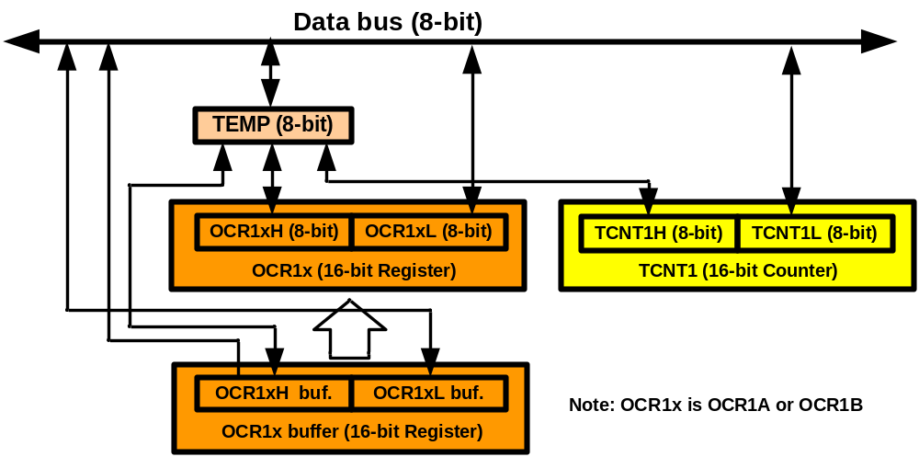
TEMP register
LDI R20,0xF3
OUT TCNT1H,R20
LDI R20,0x53
OUT TCNT1L,R20
IN R20,TCNT1L
IN R21,TCNT1H
a = TCNT1L;
b = TCNT1H;
TCNT1H = 0xF3;
TCNT1L = 0x53;

Slide 32
Assuming XTAL = 10 MHz write a program that toggles PB5 once per millisecond, using CTC mode.
.INCLUDE "M32DEF.INC"
LDI R16,HIGH(RAMEND)
OUT SPH,R16
LDI R16,LOW(RAMEND)
OUT SPL,R16
SBI DDRB,5 ;PB5 as an output
BEGIN:SBI PORTB,5 ;PB5 = 1
RCALL DELAY_1ms
CBI PORTB,5 ;PB5 = 0
RCALL DELAY_1ms
RJMP BEGIN
DELAY_1ms:
LDI R20,0x00
OUT TCNT1H,R20 ;TEMP = 0
OUT TCNT1L,R20 ;TCNT1L = 0, TCNT1H = TEMP
LDI R20,0x27
OUT OCR1AH,R20 ;TEMP = 0x27
LDI R20,0x0F
OUT OCR1AL,R20 ;OCR1AL = 0x0F, OCR1AH = TEMP
LDI R20,0x3
OUT TCCR1A,R20 ;WGM11:10=11
LDI R20,0x19
OUT TCCR1B,R20 ;WGM13:12=11,CS=CLK
AGAIN:
IN R20,TIFR ;read TIFR
SBRS R20,OCF1A ;if OCF1A is set skip next instruction
RJMP AGAIN
LDI R20,1<<OCF1A
OUT TIFR,R20 ;clear OCF1A flag
LDI R19,0
OUT TCCR1B,R19 ;stop timer
OUT TCCR1A,R19 ;
RET

Slide 33
Counting

Slide 34
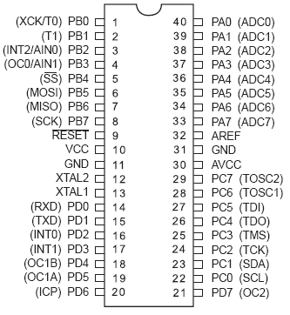
Counting
T0
6
7

Slide 35
Example Assuming that clock pulses are fed into pin T0, write a program for counter 0 in normal mode to count the pulses on falling edge and display the state of the TCNT0 count on PORTC.
.INCLUDE "M32DEF.INC"
CBI DDRB,0 ;make T0 (PB0) input
LDI R20,0xFF
OUT DDRC,R20 ;make PORTC output
LDI R20,0x06
OUT TCCR0,R20 ;counter, falling edge
AGAIN:
IN R20,TCNT0
OUT PORTC,R20 ;PORTC = TCNT0
IN R16,TIFR
SBRS R16,TOV0
RJMP AGAIN ;keep doing it
LDI R16,1<<TOV0
OUT TIFR, R16
RJMP AGAIN ;keep doing it

Slide 36
Assuming that clock pulses are fed into pin T1. Write a program for counter 1 in CTC mode to make PORTC.0 high every 100 pulses.
.INCLUDE "M32DEF.INC"
CBI DDRB,1 ;make T1 (PB1) input
SBI DDRC,0 ;PC0 as an output
LDI R20,0x0
OUT TCCR1A,R20
LDI R20,0x0E
OUT TCCR1B,R20 ;CTC, counter, falling edge
AGAIN:
LDI R20,0
OUT OCR1AH,R20 ;TEMP = 0
LDI R20,99
OUT OCR1AL,R20 ;ORC1L = R20, OCR1H = TEMP
L1: IN R20,TIFR
SBRS R20,OCF1A
RJMP L1 ;keep doing it
LDI R20,1<<OCF1A ;clear OCF1A flag
OUT TIFR, R20
SBI PORTC,0 ;PC0 = 1
CBI PORTC,0 ;PC0 = 0
RJMP AGAIN ;keep doing it

Slide 37
Wave generating and Capturing

Slide 38
Topics
Wave characteristics
  Music and frequencies
Timer0 review
Wave generating using Timer0
Wave generating using Timer2
Wave generating using Timer1
Capturing

Slide 39
Wave characteristics
Period
  Frequency
Duty cycle
Amplitude
1
T
f =
T
T
t₀
t₀
duty cycle =
×100 =
×100
T
t₀ + t₁
t₀
t₁

Slide 40
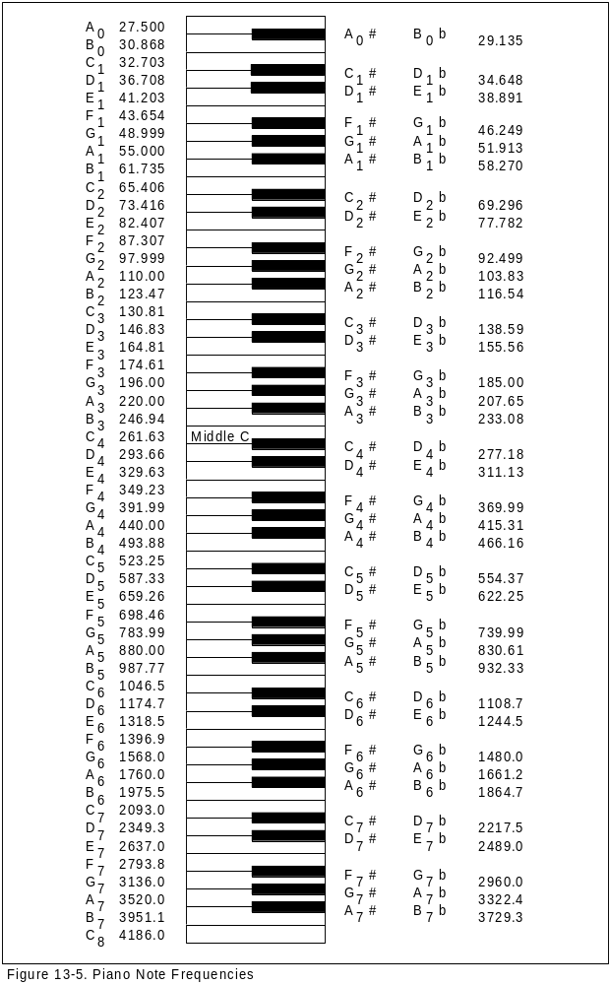
Music and Frequencies
Music

Slide 41
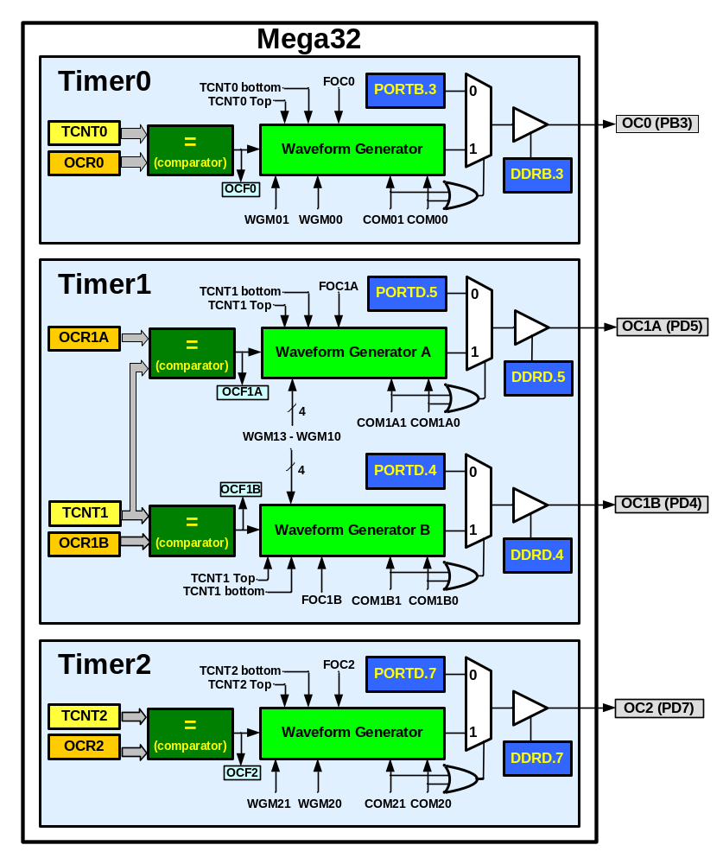
Waveform generators in ATmega32

Slide 42
Timer0 Review
TCCR0
TCNT0
TOV0
=
OCF0
OCR0

Slide 43
Clock Selector (CS)
Timer Mode (WGM)
CS02 CS01 CS00 Comment
0 0 0 No clock source (Timer/Counter stopped)
0 0 1 clk (No Prescaling)
0 1 0 clk / 8
0 1 1 clk / 64
1 0 0 clk / 256
1 0 1 clk / 1024
1 1 0 External clock source on T0 pin. Clock on falling edge
1 1 1 External clock source on T0 pin. Clock on rising edge
WGM00 WGM01 Comment
0 0 Normal
0 1 CTC (Clear Timer on Compare Match)
1 0 PWM, phase correct
1 1 Fast PWM

Slide 44
Normal mode
TCNT0
0xFF
TOV
TOV
TOV
0
time
FF
0
FE
TOV0:
1
2
1
0
TOV0 = 1

Slide 45
CTC (Clear Timer on Compare match) mode
TCNT0
0xFF
OCR0
OCF0
OCF0
OCF0
0
time
OCR0
TOV0:
0
xx
2
0
OCF0:
1
1
0
TOV0 = no change
OCF0 = 1

Slide 46
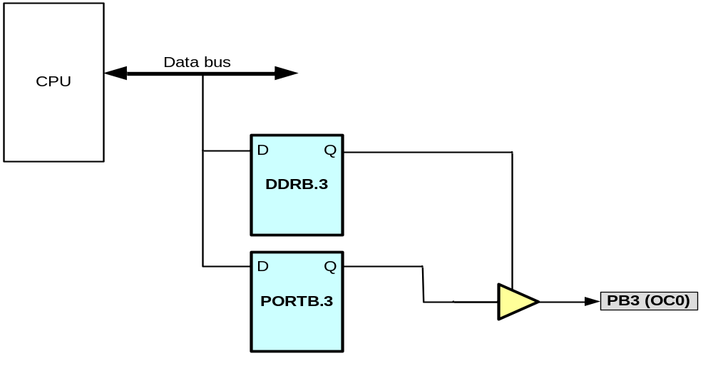
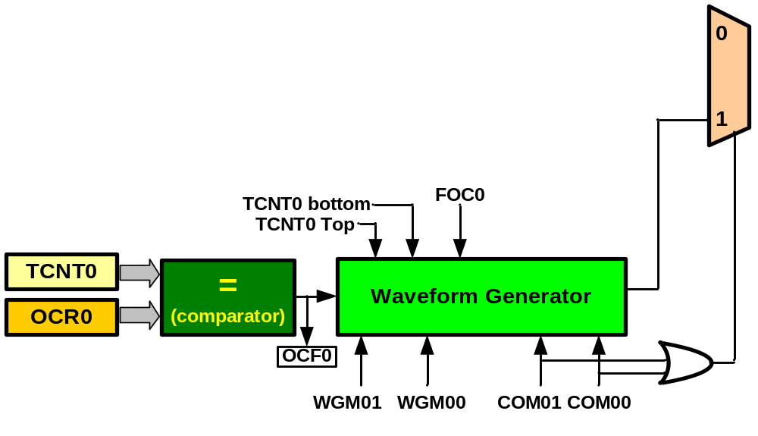
Waveform Generator

Slide 47
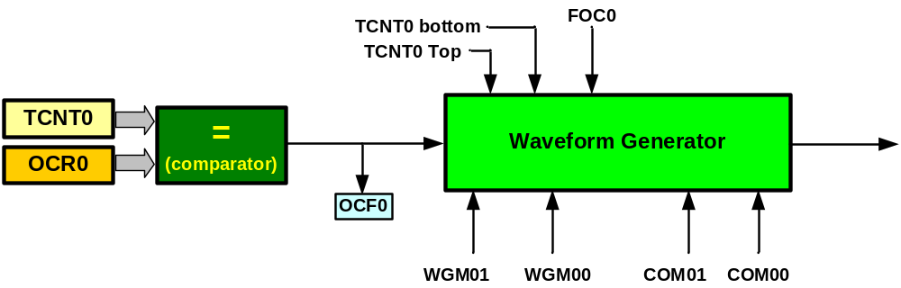
Waveform Generator

Slide 48
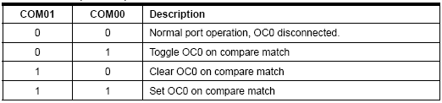
TCNT0
CTC, Toggle Mode
Duty cycle = 50%
Frequency = changeable
Compare Output Mode (COM)
0xFF
OCR0
OCF0
OCF0
OCF0
WGM00 WGM01 Mode
0 0 Normal
0 1 CTC (Clear Timer on Compare Match)
1 0 PWM, phase correct
1 1 Fast PWM
0
OC0
f_{clk}
F_{OC0}=
2N(OCR0+1)
TCNT0
0xFF
OCR0
OCF0
OCF0
0
OC0

Slide 49
Assuming XTAL = 8 MHz, make a pulse with duty cycle = 50% and frequency = 500KHz
f_{clk}
8MHz
8MHz
F_{OC0}=
500KHz=
N(OCR0+1) =
2N(OCR0+1)
2N(OCR0+1)
1MHz
N = 1 and OCR0 = 7
N(OCR0+1) = 8
N = 8 and OCR0 = 0
LDI R20,7
OUT OCR0,R20
LDI R20,0x19
OUT TCCR0,R20
OCR0 = 7;
TCCR0 = 0x19; //prescaler = 1
LDI R20,0
OUT OCR0,R20
LDI R20,0x1A
OUT TCCR0,R20
OCR0 = 0;
TCCR0 = 0x1A; //prescaler = 8

Slide 50
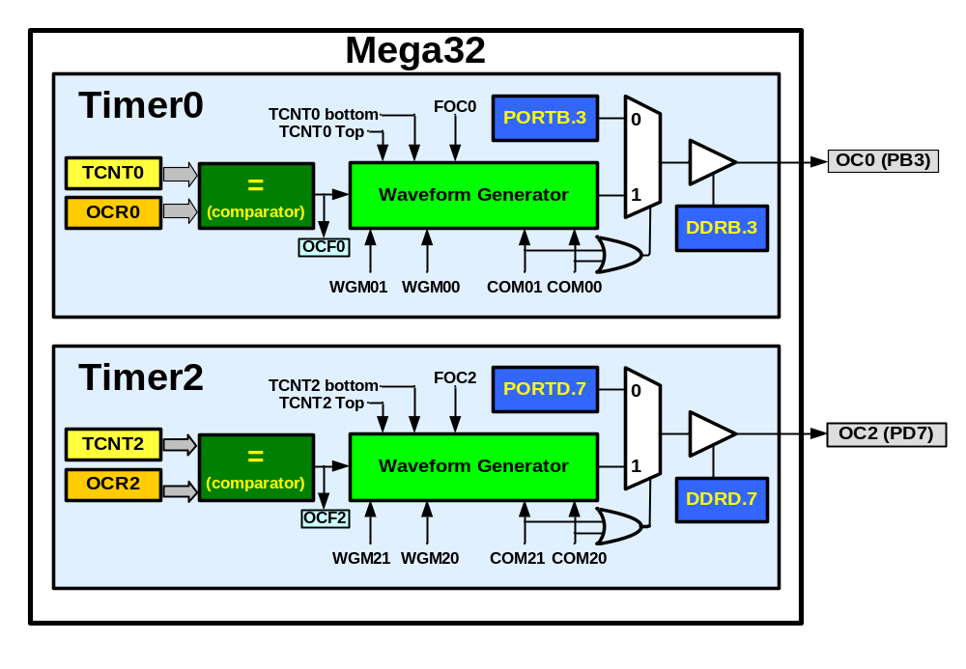
Wave generating in Timer2
Like Timer0

Slide 51
The difference between Timer0 and Timer2
Timer0
Timer2
CS02 CS01 CS00 Comment
0 0 0 Timer/Counter stopped
0 0 1 clk (No Prescaling)
0 1 0 clk / 8
0 1 1 clk / 64
1 0 0 clk / 256
1 0 1 clk / 1024
1 1 0 External clock (falling edge)
1 1 1 External clock (rising edge)
CS22 CS21 CS20 Comment
0 0 0 Timer/Counter stopped
0 0 1 clk (No Prescaling)
0 1 0 clk / 8
0 1 1 clk / 32
1 0 0 clk / 64
1 0 1 clk / 128
1 1 0 clk / 256
1 1 1 clk / 1024

Slide 52
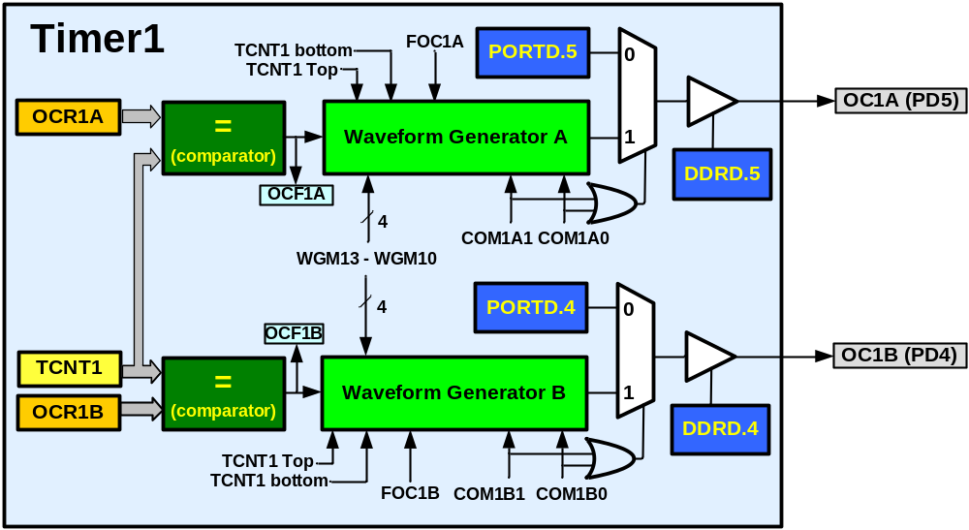
Timer1
Timer1 has two waveform generators

Slide 53
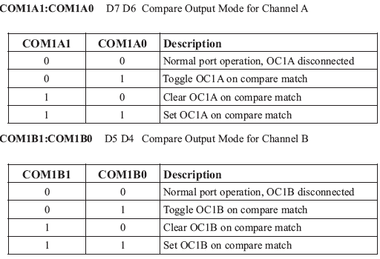
In non PWM modes

Slide 54
Capturing in Timer/counter 1

Slide 55
Capturing
Usages
  Measuring duty cycle
  Measuring period
TCNT1H TCNT1L
ICR1H ICR1L

Slide 56
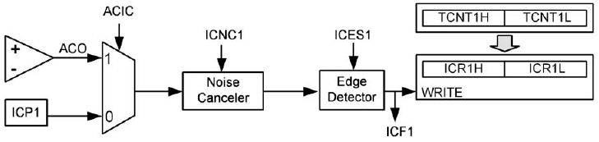
Capturing

Slide 57
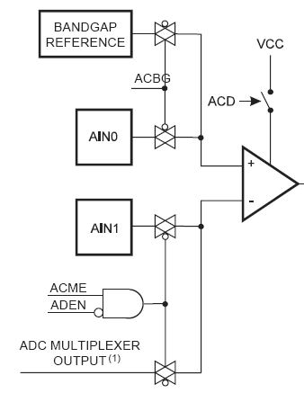
Comparator
Copied from ATmega32 datasheet page 196

Slide 58

ICNC1: Input Capture Noise Canceller
0:disabled
1:Enabled (captures after 4 successive equal valued samples)
ICSES1: Input Capture Edge Select
0: Falling edge
1: Rising edge
ACIC: Analog Comparator Input Capture Enable
0: ICP1 provides the capture signal
1: analog comparator is connected to the capturer

Slide 59
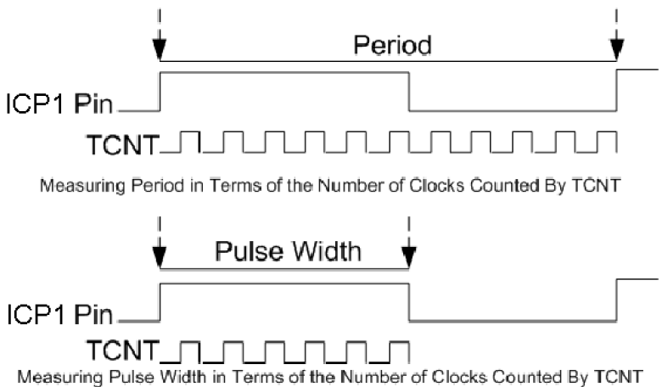
Measuring duty cycle and period

Slide 60
DC motor and PWM

Slide 61
Topics
DC motor
  Unidirectional control
  Bidirectional control
PWM modes
  Wave generating using Fast PWM
  Wave generating using Phase correct PWM

Slide 62
DC motor

Slide 63

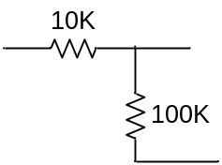
Unidirectional control
+12V
AVR
Analog Ground
M
VCC
Analog
Power
GND
TIP120
+5^{V}
Digital Ground

Slide 64
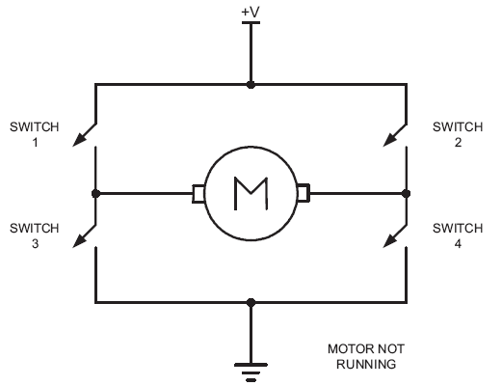
Bidirectional control

Slide 65
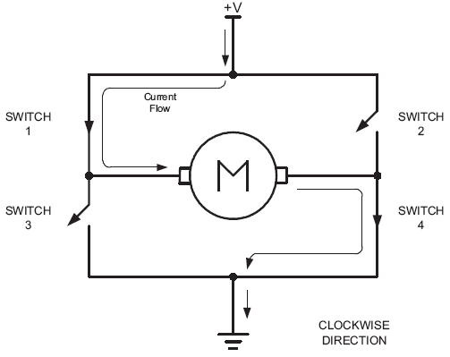
Bidirectional (clock wise)

Slide 66
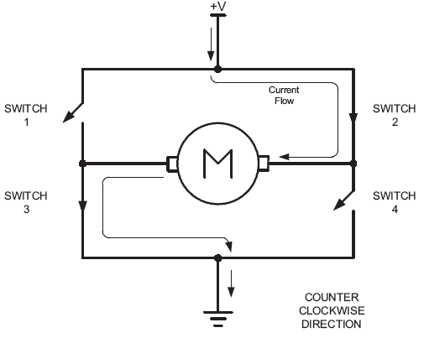
Bidirectional (counter clockwise)

Slide 67
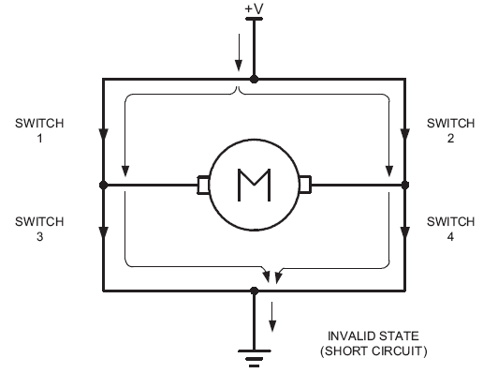
Bidirectional

Slide 68
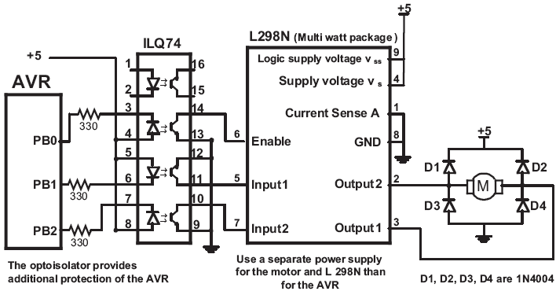
Using L298N

Slide 69
Timer0 Review
TCCR0
TCNT0
TOV0
=
OCF0
OCR0

Slide 70
Clock Selector (CS)
Timer Mode (WGM)
CS02 CS01 CS00 Comment
0 0 0 No clock source (Timer/Counter stopped)
0 0 1 clk (No Prescaling)
0 1 0 clk / 8
0 1 1 clk / 64
1 0 0 clk / 256
1 0 1 clk / 1024
1 1 0 External clock source on T0 pin. Clock on falling edge
1 1 1 External clock source on T0 pin. Clock on rising edge
WGM00 WGM01 Comment
0 0 Normal
0 1 CTC (Clear Timer on Compare Match)
1 0 PWM, phase correct
1 1 Fast PWM

Slide 71
Fast PWM mode
Similar to Normal mode but OCR0 is buffered.
0
TCNT0
TOV0:
1
0xFF
TOV
TOV
TOV
0
time
TCNT0
FF
TOV0
=
OCF0
FE
OCR0
2
1
TOV0
0
TOV0 = 1
OCR0-BUF

Slide 72
Phase Correct PWM mode
Goes up and down like a yo-yo
When TCNT becomes zero, the TOV0 flag sets.
0
TCNT0
TOV0:
1
0xFF
0
TOV
time
FF
TCNT0
FE
TOV0
=
OCF0
2
OCR0
TCNT0=0xFF
1
0
TOV0 = 1
OCR0-BUF

Slide 73
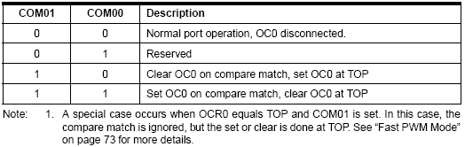
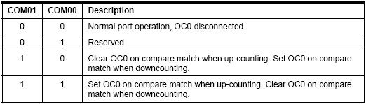
Compare Output Mode (COM)
CTC or Normal (Non PWM)
Fast PWM
Phase Correct PWM

Slide 74
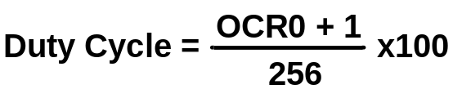
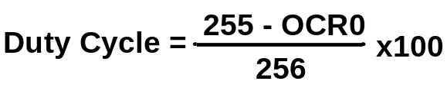
Fast PWM
Duty cycle = changeable (0% to 100%)
Frequency = selectable between limited choices
Phase Correct PWM
Compare Output Mode (COM)
CTC or Normal (Non PWM)
TCNT0
TCNT0
0xFF
0xFF
OCR0
OCR0
0
0
Fast PWM
OC0
OC0
COM=2
OC0
OC0
COM=3
f_{clk}
F_{OC0}=
N(256)

Slide 75
Assuming XTAL = 8 MHz, make the following pulse duty cycle = 75% and frequency = 31.250KHz
f_{clk}
8MHz
8MHz
F_{OC0}=
31.250KHz=
N =
=1
N(256)
N(256)
31.250K*256
75/100 = (OCR0+1)/255 ➔ OCR0+1 = 191 = 0xBF ➔ OCR0 = 0xBE
LDI R20,0xBE
OUT OCR0,R20
LDI R20,0x79
OUT TCCR0,R20
OCR0 = 0xBE;
TCCR0 = 0x79;

Slide 76
Compare Output Mode (COM)
CTC or Normal (Non PWM)
Fast PWM
Phase Correct PWM

Slide 77
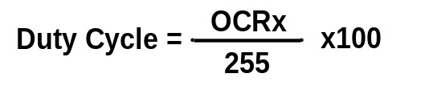
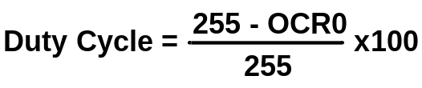
Phase Correct PWM
Duty cycle = changeable (0% to 100%)
Frequency = selectable between limited choices
Compare Output Mode (COM)
TCNT0
CTC or Normal (Non PWM)
TCNT0
0xFF
0xFF
OCR0
OCR0
0
0
OC0
Fast PWM
OC0
COM=2
OC0
OC0
COM=3
Phase Correct PWM
f_{clk}
F_{OC0}=
N(510)

Slide 78
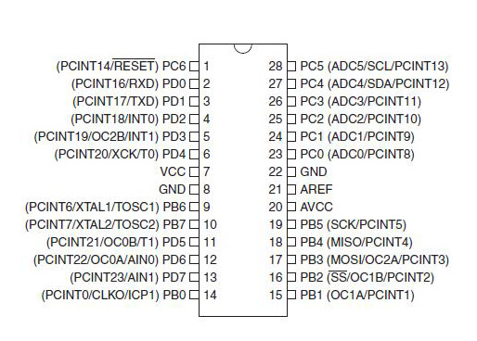
Alternate Pins for PDIP Package

